Slide 1
Figurative Language
“Figuring it Out”

Slide 2
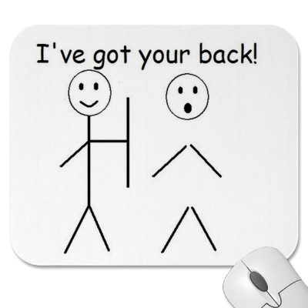
Figurative and Literal Language
Literally: words function exactly as defined
The car is blue.
He caught the football.
Figuratively: figure out what it means
I’ve got your back.
You’re a doll.
^Figures of Speech

Slide 3
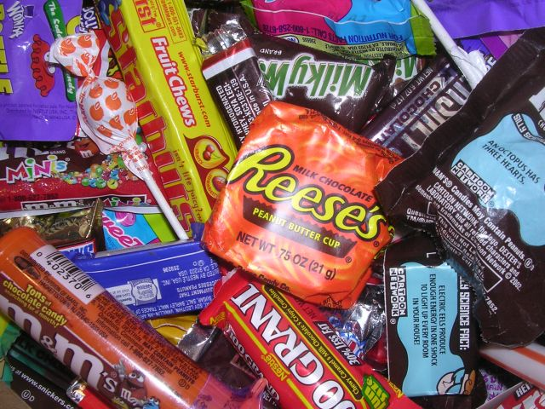
Simile
Comparison of two things using “like” or “as.”
Examples
The metal twisted like a ribbon.
She is as sweet as candy.

Slide 4
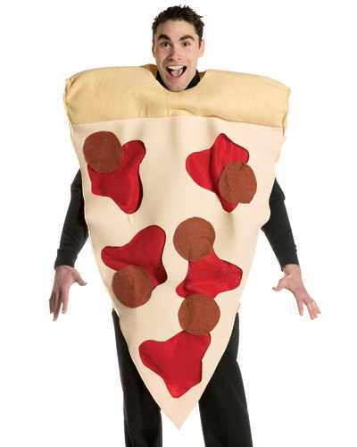
Important!
Using “like” or “as” doesn’t make a simile.
A comparison must be made.
Not a Simile: I like pizza.
Simile: The moon is like a pizza.

Slide 5
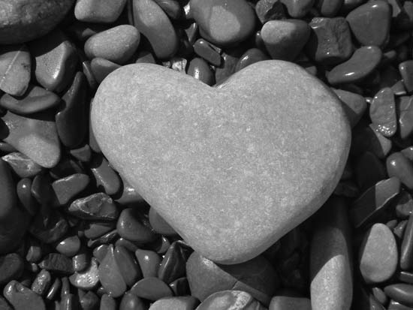
Metaphor
Two things are compared without using “like” or “as.”
Examples
All the world is a stage.
Men are dogs.
Her heart is stone.

Slide 6
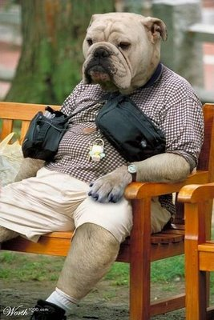
Personification
Giving human traits to objects or ideas.
Examples
The sunlight danced.
Water on the lake shivers.
The streets are calling me.

Slide 7
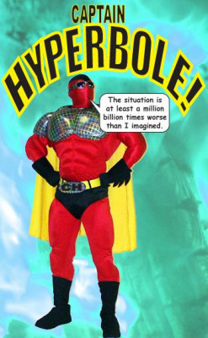
Hyperbole
Exaggerating to show strong feeling or effect.
Examples
I will love you forever.
My house is a million miles away.
She’d kill me.

Slide 8
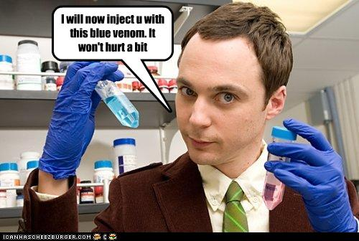
Understatement
Expression with less strength than expected.
The opposite of hyperbole.
I’ll be there in one second.
This won’t hurt a bit.

Slide 9
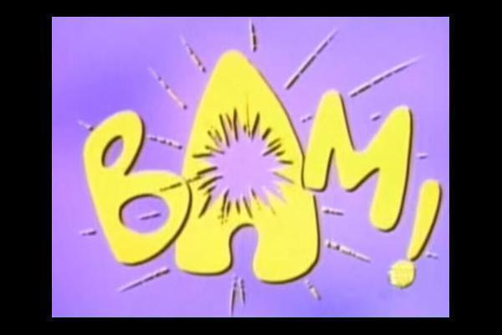
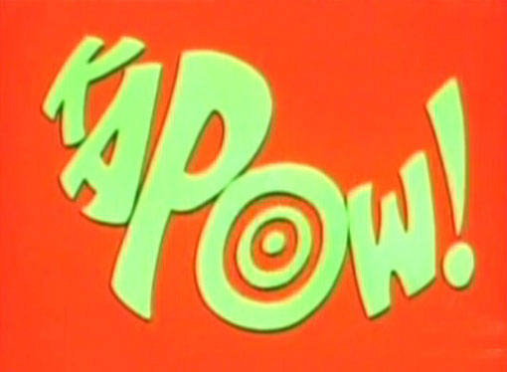
Onomatopoeia
A word that “makes” a sound
SPLAT
PING
SLAM
POP
POW

Slide 10
Idiom
A saying that isn’t meant to be taken literally.
Doesn’t “mean” what it says
Don’t be a stick in the mud!
You’re the apple of my eye.
I have an ace up my sleeve.

Slide 11
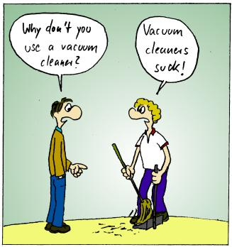
Pun
A form of “word play” in which words have a double meaning.
I wondered why the baseball was getting bigger and then it hit me.
I’m reading a book about anti-gravity. It’s impossible to put it down.
I was going to look for my missing watch, but I didn’t have the time.

Slide 12
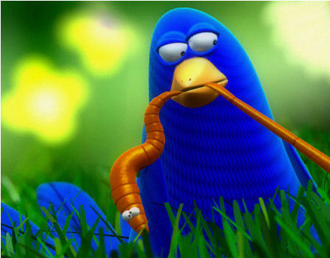
Proverb
A figurative saying in which a bit of “wisdom” is given.
An apple a day keeps the doctor away
The early bird catches the worm

Slide 13
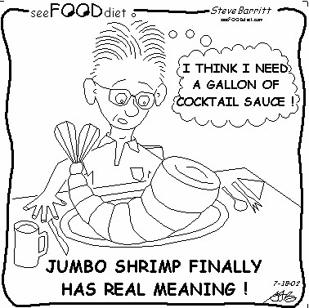
Oxymoron
When two words are put together that contradict each other. “Opposites”
Jumbo Shrimp
Pretty Ugly
Freezer Burn

Slide 14
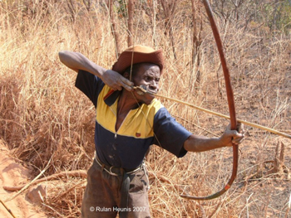
1
He drew a line as straight as an arrow.

Slide 15
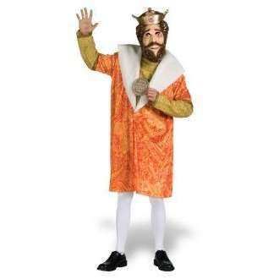
2
Knowledge is a kingdom and all who learn are kings and queens.

Slide 16
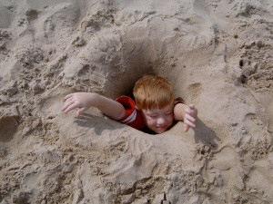
3
Can I see you for a second?

Slide 17
4
The sun was beating down on me.

Slide 18
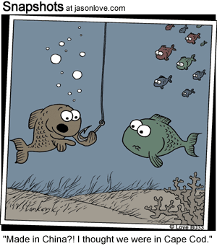
5
A flag wags like a fishhook there in the sky.

Slide 19
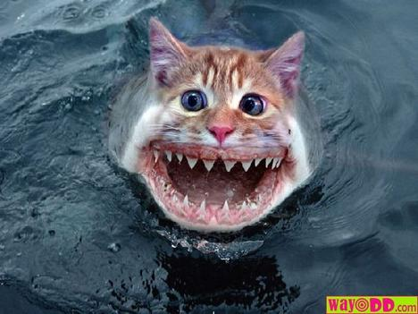
6
I'd rather take baths with a man-eating shark, or wrestle a lion alone in the dark, eat spinach and liver, pet ten porcupines, than tackle the homework, my teacher assigns.

Slide 20
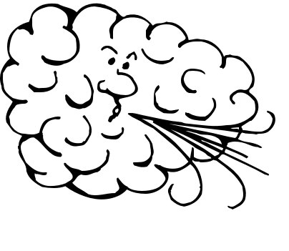
7
Ravenous and savage from its long polar journey, the North Wind is searching for food—

Slide 21
8
Dinner is on the house.

Slide 22
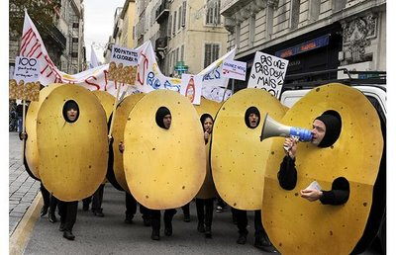
9
Can I have one of your chips?

Slide 23
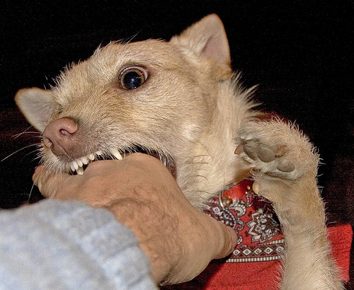
10
Don’t bite the hand that feeds you.

Slide 24
11.
The clouds smiled down at me.

Slide 25
12.
SPLAT!

Slide 26
13.
She is as sweet as candy

Slide 27
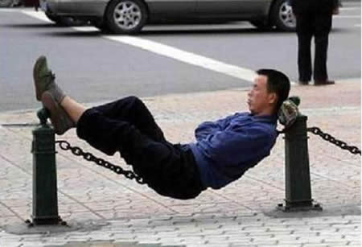
14.
I could sleep forever!

Slide 28
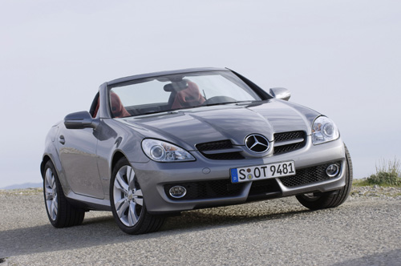
15.
He drove his expensive car into a tree and found out how the Mercedes bends

Slide 29
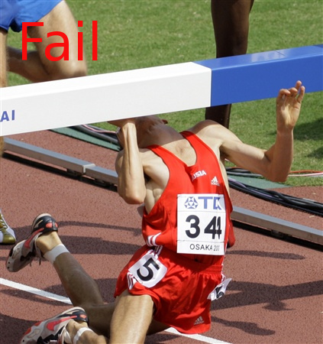
16.
I used to have a fear of hurdles, but I got over it

Slide 30
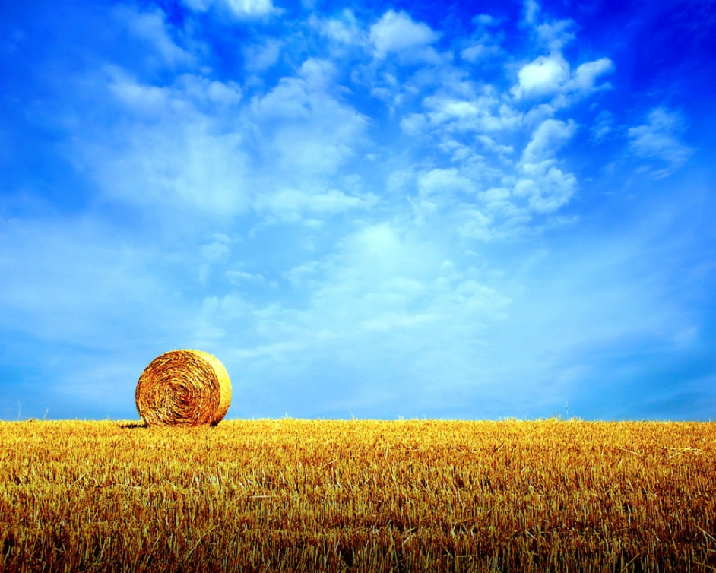
17.
The wheat field was a sea of gold.

Slide 31
18.
The streets called to him.

Slide 32
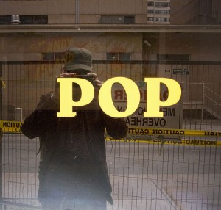
19.
POP!

Slide 33
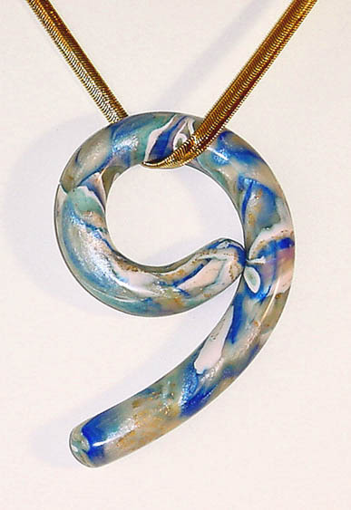
20.
She was dressed to the nines.

Slide 34
21.
The early bird catches the worm.

Slide 35
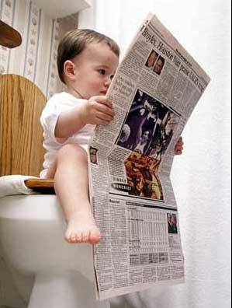
22.
Old news

Slide 36
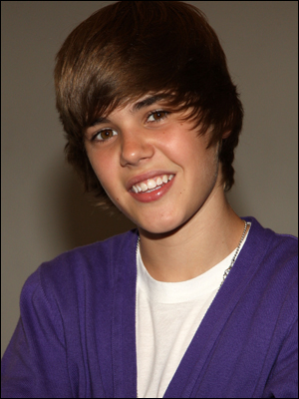
23.
Your face is killing me!

Slide 37
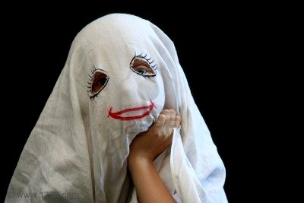
24.
She was as white as a ghost.

Slide 38
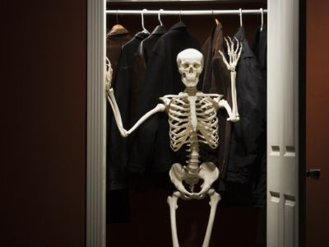
25.
She has a skeleton in her closet.

