Slide 1
Introduction to Literature Circles
The Andromeda Strain

Slide 2
What are Literature Circles?
small discussion groups of students who are reading the same book
each member has a job, which changes each meeting

Slide 3
Literature Circles Jobs
Discussion Director
Illustrator
Literary Luminary
Vocabulary Enricher

Slide 4
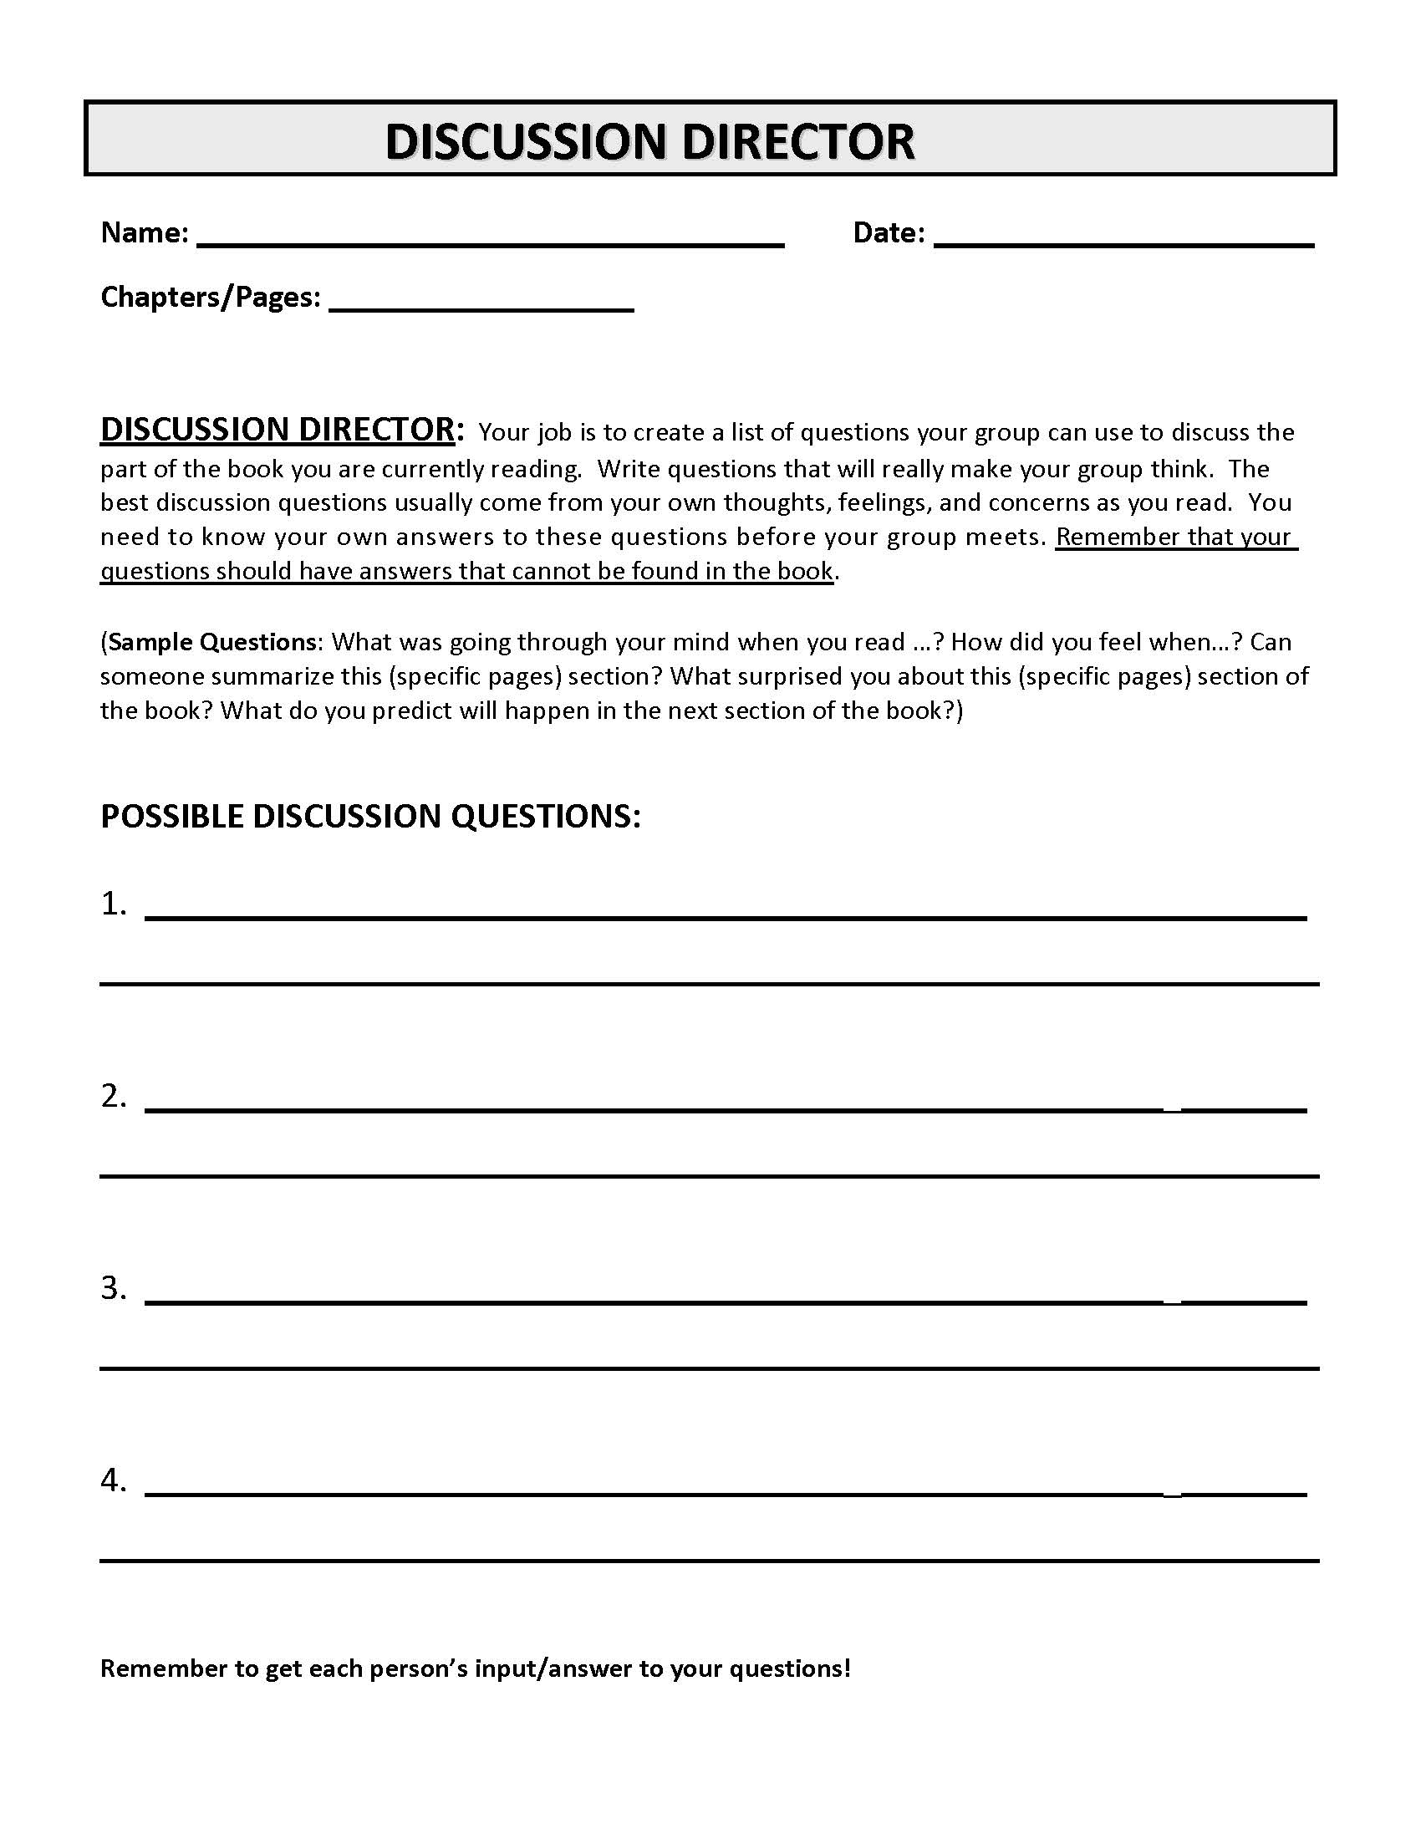
DISCUSSION DIRECTOR:
directs discussion
prepares higher-level thinking questions that lead to discussion by the group

Slide 5
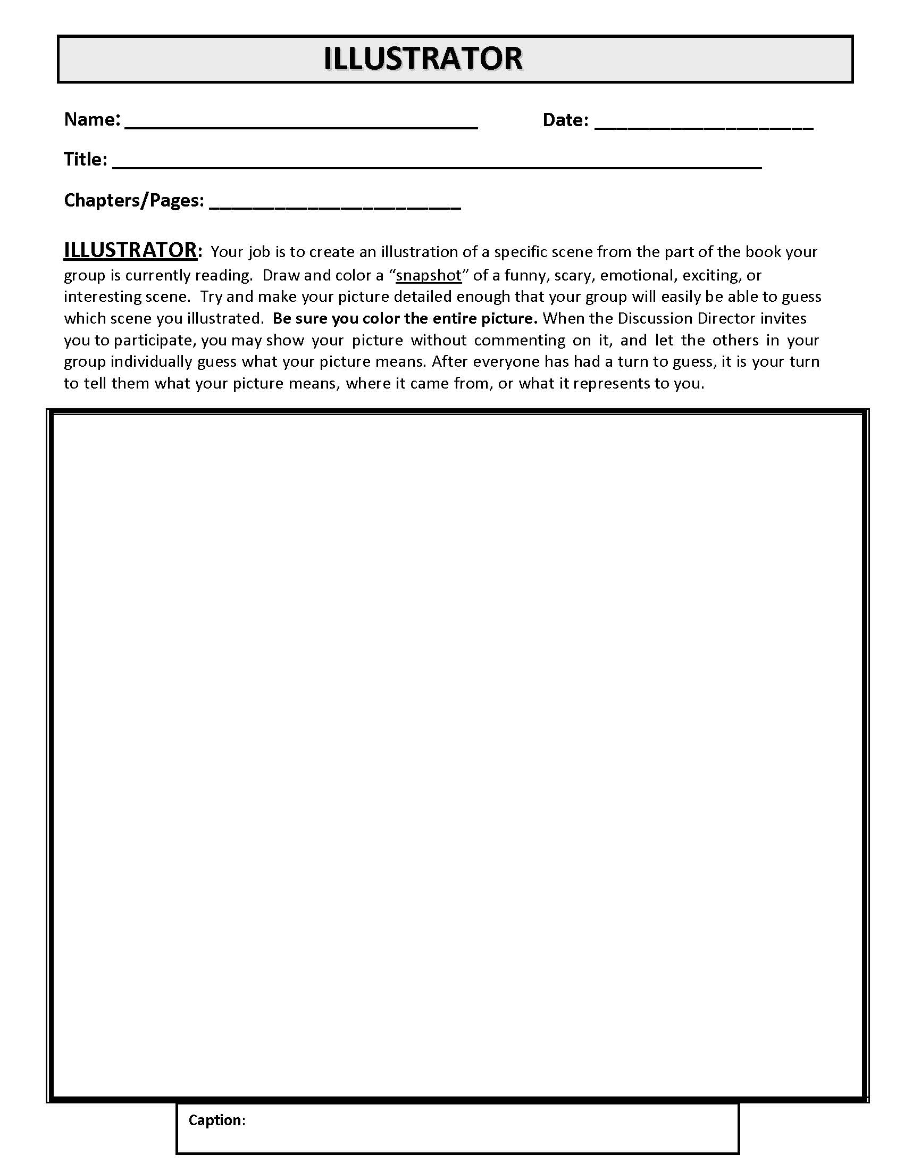
ILLUSTRATOR
prepares picture related to reading —sketch, cartoon, diagram, flow-chart, or stick-figure scene
explains rationale

Slide 6
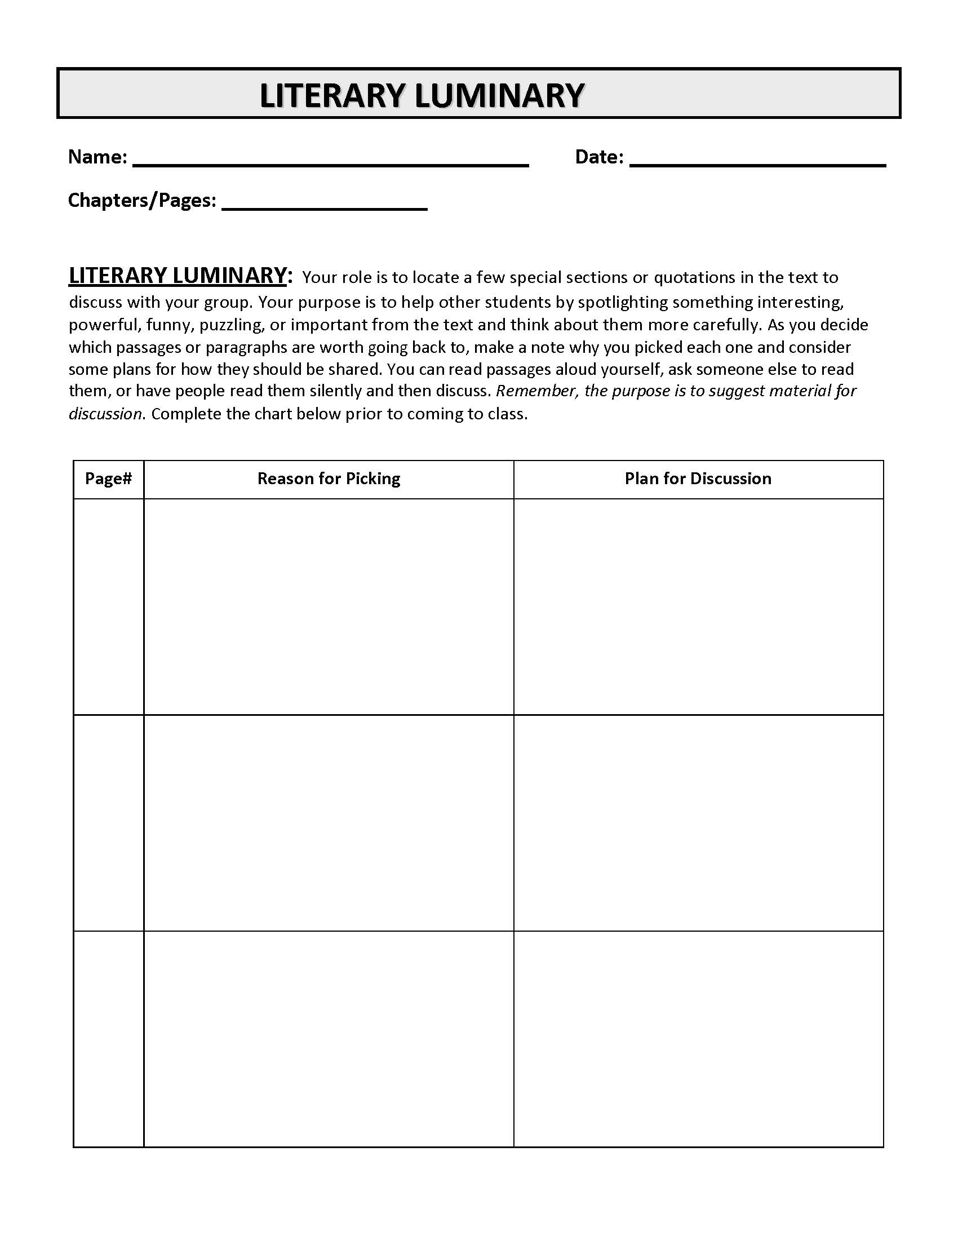
LITERARY LUMINARY
points out important passages within the reading
interesting
powerful
funny
puzzling
important
provides rationale

Slide 7
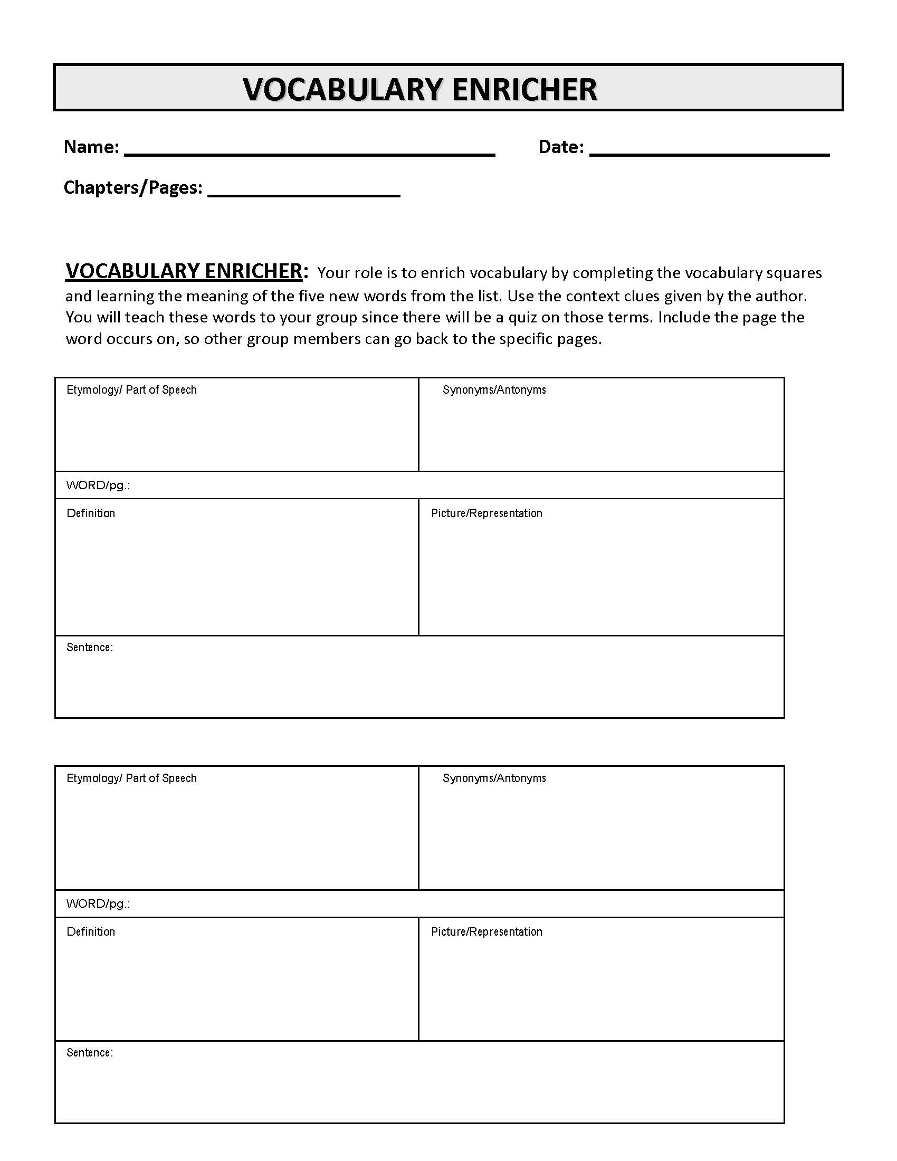
VOCABULARY ENRICHER
completes vocabulary squares and learns meaning of the five words provided
defines and discusses these words with the group
teaches words to group

Slide 8
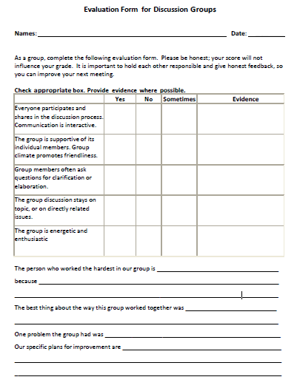
GROUP EVALUATION
At the end of each meeting, complete a group evaluation sheet.
Be honest so that you can improve the next meeting!

Slide 9
SUMMARIES
Each individual student writes important events of assigned reading on notebook paper.
Summaries can be written in paragraph format or bullet points.
Include any questions that you had about the reading on your summary page.

Slide 10
PROCEDURES
Before Meeting
Complete required reading
Complete role/job sheets
Complete discussion questions by due dates.
Complete parts of final project

Slide 11
PROCEDURES
During Meeting
Discuss your role/job sheet
Talk about anything interesting, confusing, exciting, etc. (everyone MUST participate)
Share thoughts about discussion questions
Discuss/compare research
Work on Final Project

Slide 12
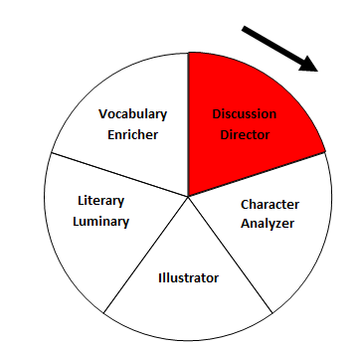
PROCEDURES
After/At the End of Meeting
Assign jobs and role sheets
Job Wheel
Complete Evaluation Sheet
Group evaluation - discussion
Turn in job sheets and evaluations

Slide 13
“CIRCLE TIME” - Model
15-30 minutes - share job responsibilities with group members and have an open conversation about the book
5 minutes – assign new jobs for next class meeting
10-15 minutes – share discussion question responses
discuss/work on final project
group evaluations

Slide 14
ASSESSMENT Based on:
Role Sheets
Evaluation Sheets
Summaries

Slide 15
PENALTIES
During your first group meeting, decide on penalties for:
Absent students
Incomplete job sheets
Non-participation
Remember, you will lose points and/or have more work to do if other students don’t do their part.

