Slide 1
MLA Documentation & Style

Slide 2
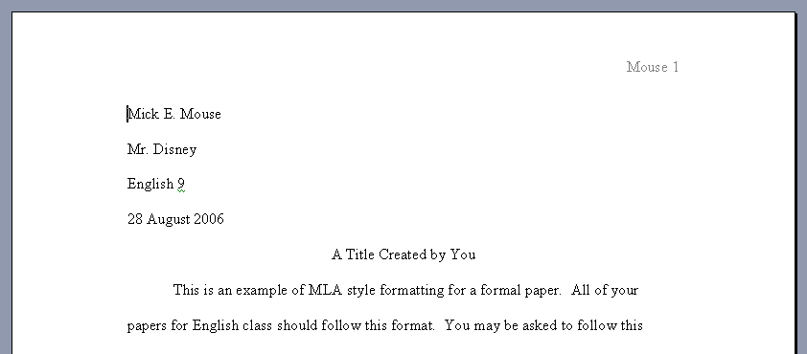
Formal MLA Format
1”
Header
Heading
1”
Title

Slide 3
Margins and Spacing
Change all margins to 1”
Select FILE
Select PAGE SETUP
Reduce right and left margins to 1”
Double space the entire document (THERE ARE NO EXCEPTIONS!)
Select FORMAT
Select PARAGRAPH
Select LINE SPACING, choose DOUBLE

Slide 4
Header
Insert a header with your last name and the page number
Select VIEW
Select HEADER/FOOTER
Select right justification
Type your last name only
Click page number icon
Select close

Slide 5
Heading
Create the heading
Type your full name
Type your teacher’s name
Type the name of the class – no abbreviations!
Type the date in MLA Style (smallest to largest)
Day Month Year
Notes:
t

Slide 6
Title and Text
Create a title
Select center justification
Capitalize all important words (and first and last)
DO NOT: Underline, Italicize, Boldface
Make the title clever but indicative of your subject and direction
Begin your text – NO extra spaces!
Save your document

Slide 7
Quotation vs. Paraphrase
Direct copy of the text
Word-for-word restatement
Uses quotation marks
Uses parenthetical citation
Summary restatement of the text
SIGNIFICANT changes to syntax and diction
No quotation marks
Uses parenthetical citation

Slide 8
Syntax Diction
Structure
Of the sentence
Of the clauses
Of the phrases
Word choice
SIGNIFICANT CHANGES means there should be few – but preferably no – repetitions of words or structure

Slide 9
Quote Paraphrase
“Admissions officers see themselves as being responsible to their school as a whole. They are building a freshman class, which must become a successful part of the college or university at large.”
The job of the admissions officer is to select students for the freshman class who will contribute to the overall success of the college or university.

Slide 10
Formatting Quotations
Citation follows the quotation directly
At the time we thought, “gone are the days of care” (Frick 29), but now we know different.
Punctuation always outside parenthesis
Do dreams always “alter our perception of waking reality” (Wilson 8)?

Slide 11
Formatting Quotations
Long quotations (+4 typed lines) should be blocked
Indent one additional tab
No quotation marks
Citation outside of punctuation

Slide 12
Formatting Quotations
Omit words using ellipses
Pete remembers, “It was like he changed . . .right before my eyes” (97).
Add words using brackets
He explains, “There is no escape anywhere . . . .It is impossible to break through [the daggers of flames]” (66).

Slide 13
MLA Documentation
Refer to the works of others in your text (quotation and paraphrase) with parenthetical citation:
Human beings have been described as "symbol-using animals" (Burke 3).
In-text parenthetical citation corresponds with an entry on Works Cited page
Burke, Kenneth. Language as Symbolic Action: Essays on Life, Literature, and Method. Berkeley: U of California P, 1966.

Slide 14
Be careful!
Plagiarism = a citation that appears in your paper but is not accompanied by a correct Works Cited reference
Plagiarism = a Works Cited reference that has no corresponding parenthetical citation in the text of the paper

Slide 15
Parenthetical Citation
Usually contains (Jones 54).
Author’s last name
Page number for that information
No page number?
Author’s last name only
No author?
Title of the work (full the first time)
Underline or use Quotation Marks as appropriate
No comma!

Slide 16
Parenthetical Citation
May contain only the page number IF:
The previous citation was from the same source, only a different page
The author’s name appears in the lead-in/context of the quote/paraphrase
Morrison aptly concludes the novel’s quest theme with Milkman’s final insight: “if you surrendered to the air, you could ride it” (337).

Slide 17
Parenthetical Citation
Use it when:
You quote directly from the source
You paraphrase (change SYNTAX and DICTION) from the source
Don’t use it when:
You refer to common knowledge
You quote familiar proverbs
You quote common quotations
When in doubt, USE IT!

Slide 18
Parenthetical Citation
Should directly follow information cited
Multiple sentences from the same page of same source? Citation follows the last.
Should appear as part of the sentence
…as Kennedy did in 1963 (Brown 6).

Slide 19
Parenthetical Citation
Two authors with same last name?
Include first initial (or first name if same)
Two works by same author?
Include title: (Jones, “Waking Up” 54).
Indirect source?
Include “qtd. in”:
Ulrich argues that high school has become “a stomping ground for thugs” (qtd. in Jones 54).

Slide 20
Works Cited Format
Begins after the last page of the paper (a separate page from all other text)
Includes the header with the last page number W:\Miller\Students Read Only\mla formatting.doc
Is double spaced as the rest of the paper (NO EXTRA SPACES!)
Has the words Works Cited centered at the top of the page (no bold, underline or quotation marks)

Slide 21
Works Cited Format
Has all entries alphabetized by first information (usu. author’s last name)
Uses a “hanging indent” for all entries
Backwards of a paragraph (or first line indent)
Means the first line is not indented, but all subsequent lines are
Go to FORMAT, select PARAGRAPH, under indentation select SPECIAL and HANGING W:\Miller\Students Read Only\mla formatting.doc

Slide 22
Works Cited Citations
General format for most sources:
Author’s last name, first name.
Title of the Work. (short piece titles in quotation marks, long pieces in italics)
Publication information.
Sources by more than one author list all authors (up to three) with the second and third as first name last name separated by “and” (2 people) and a comma (3 people).
More than one source by an author lists subsequent sources by ---.

Slide 23
Most Common Works Cited Citations
Book by single author:
Jones, Bob. I Wish I Were an Oscar Meyer Weiner. Philadelphia: Houghton-Mifflin, 1987.
Book by multiple authors:
Crothers, Amy and Marci Smith. All I Want to Know. New York: Doubleday, 1981.

Slide 24
Most Common Works Cited Citations
Article in a daily newspaper:
McNulty, Timothy. “Ravenstahl Finds Letterman’s Spotlight Bittersweet.” Pittsburgh Post-Gazette 15 September 2006: A1.
Article in a monthly magazine:
Gray, Jim. “All Around the Mulberry Bush.” Country Living April 2001: 23-25, 27.

Slide 25
Most Common Works Cited Citations
Article in a weekly magazine:
Kendal, Geoff. “Vision and Re-Vision of Artisans.” Time 13 June 1987: 34.
On-line version of a printed magazine:
Kendal, Geoff. “Vision and Re-Vision of Artisans.” Time 13 June 1987. <http://www.time.com/13Jun1987/fo od/artisians/1348284763.html>

Slide 26
Most Common Works Cited Citations
Article from a professional website
“Disneyland Refurbishments and Additions Bring Improvements to Park.” The Disneyland Report 15 May 2006. The Disneyland Report. 15 Sept. 2006. <http://www.disneylandreport.com/di sneynews/060515-Disneyland- refurbishments-news.html>

Slide 27
Most Common Works Cited Citations
Article from a database
Brooker, Jewel Spears. "T. S. Eliot." Dictionary of Literary Biography. Peter Quartermain, ed. Gale Research Company, 1986. DISCovering Authors. Online Edition. Gale, 2003. Student Resource Center. Thomson Gale. 15 Sept. 2006
SRC Student Resource Center -- Reference Display

Slide 28
Works Cited How-to
Avoid CITATION MAKERS
Rather, LOOK IT UP:
MLA Handbook for Writers of Research Papers, 6th ed.
A Guide to MLA Documentation, 5th ed.
On-line guide to MLA style http://geocities.com/researchguide/12biblio.html

