Slide 1
Go Figure!
Figurative Language
(Idioms and Hyperbole)

Slide 2
Recognizing Figurative Language
The opposite of literal language is figurative language. Figurative language is language that means more than what it says on the surface.
It usually gives us a feeling about its subject.
Poets use figurative language almost as frequently as literal language. When you read poetry, you must be conscious of the difference. Otherwise, a poem may make no sense at all.

Slide 3
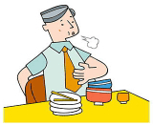
Recognizing Literal Language
I’ve eaten so much I feel as if I could literally burst!”
In this case, the person is not using the word literally in its true meaning. Literal means "exact" or "not exaggerated." By pretending that the statement is not exaggerated, the person stresses how much he has eaten.
Literal language is language that means exactly what is said.
Most of the time, we use literal language.

Slide 4
What is figurative language?
Whenever you describe something by comparing it with something else, you are using figurative language.

Slide 5
Types of Figurative Language
Simile
Metaphor
Alliteration
Personification
Onomatopoeia
Hyperbole
Idioms

Slide 6
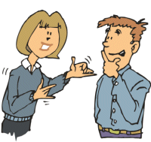
Hyperbole
An exaggerated statement used to heighten effect. It is not used to mislead the reader, but to emphasize a point.
Example: She’s said so on several million occasions.

Slide 7
Hyperbole
These books in your bag weigh a ton.
Do the books REALLY way a ton?
Meaning: The bag is very heavy.

Slide 8
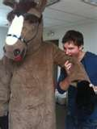
Hyperbole
I'm so hungry, I could eat a horse right now.
Can your really eat a horse?
Meaning: The person was very hungry.

Slide 9
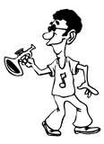
Hyperbole
Example: Jonathan practiced his trumpet forever.
Did he really practice forever?
Meaning: He practiced for a long period of time.

Slide 10
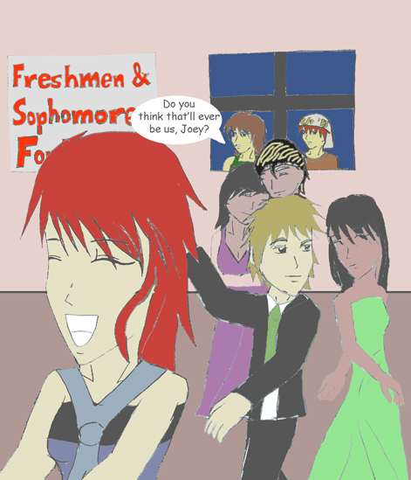
Hyperbole
I will die if he asks me to dance.
Is she really going to die if he asked her to dance?
Meaning: She will be very embarrassed if he asks her to dance.

Slide 11
Hyperbole
Cindy is doing like ten million things at the same time.
Is Cindy really doing ten million things at the same time?
Meaning: Cindy is really busy.

Slide 12
Idiom
An idiom is a phrase or expression that cannot be understood by the meaning of its separate words.
The words often have little or nothing to do with each other
every language has idioms
you will need to use context clues to help you figure them out

Slide 13
Idiom
Example: I thought I’d drop a line to see how you’re doing.
Meaning: wrote a letter or called

Slide 14
raining cats and dogs
This is an easy one since we have heard it so often.
If you don’t know what it means you need to figure it out by using context clues.

Slide 15
“Oh great! It’s raining cats and dogs outside and I forgot my umbrella.”
Why would you need an umbrella?
because it’s raining softly or hard?
It means that it is raining hard

Slide 16
hit the books
This one is still popular but maybe a little more unfamiliar to some.

Slide 17
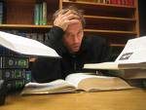
I have two tests tomorrow so tonight I’m going to have to hit the books.
If you have two tests tomorrow what would you most likely do the night before?
Study

Slide 18
crying over spilt milk
You may have heard this one but not know what it means.
Use the context clues in a sentence.

Slide 19
April’s computer quit working before she saved her ten page paper. Instead of wasting time crying over spilt milk, she decided just to get busy and start again.
Will crying make the spilt milk get back in the glass?
It means don’t complain about something you can’t change.

